Slide 1
AMER Alley Rally
May Momentum
May 6th, 2019

Slide 2
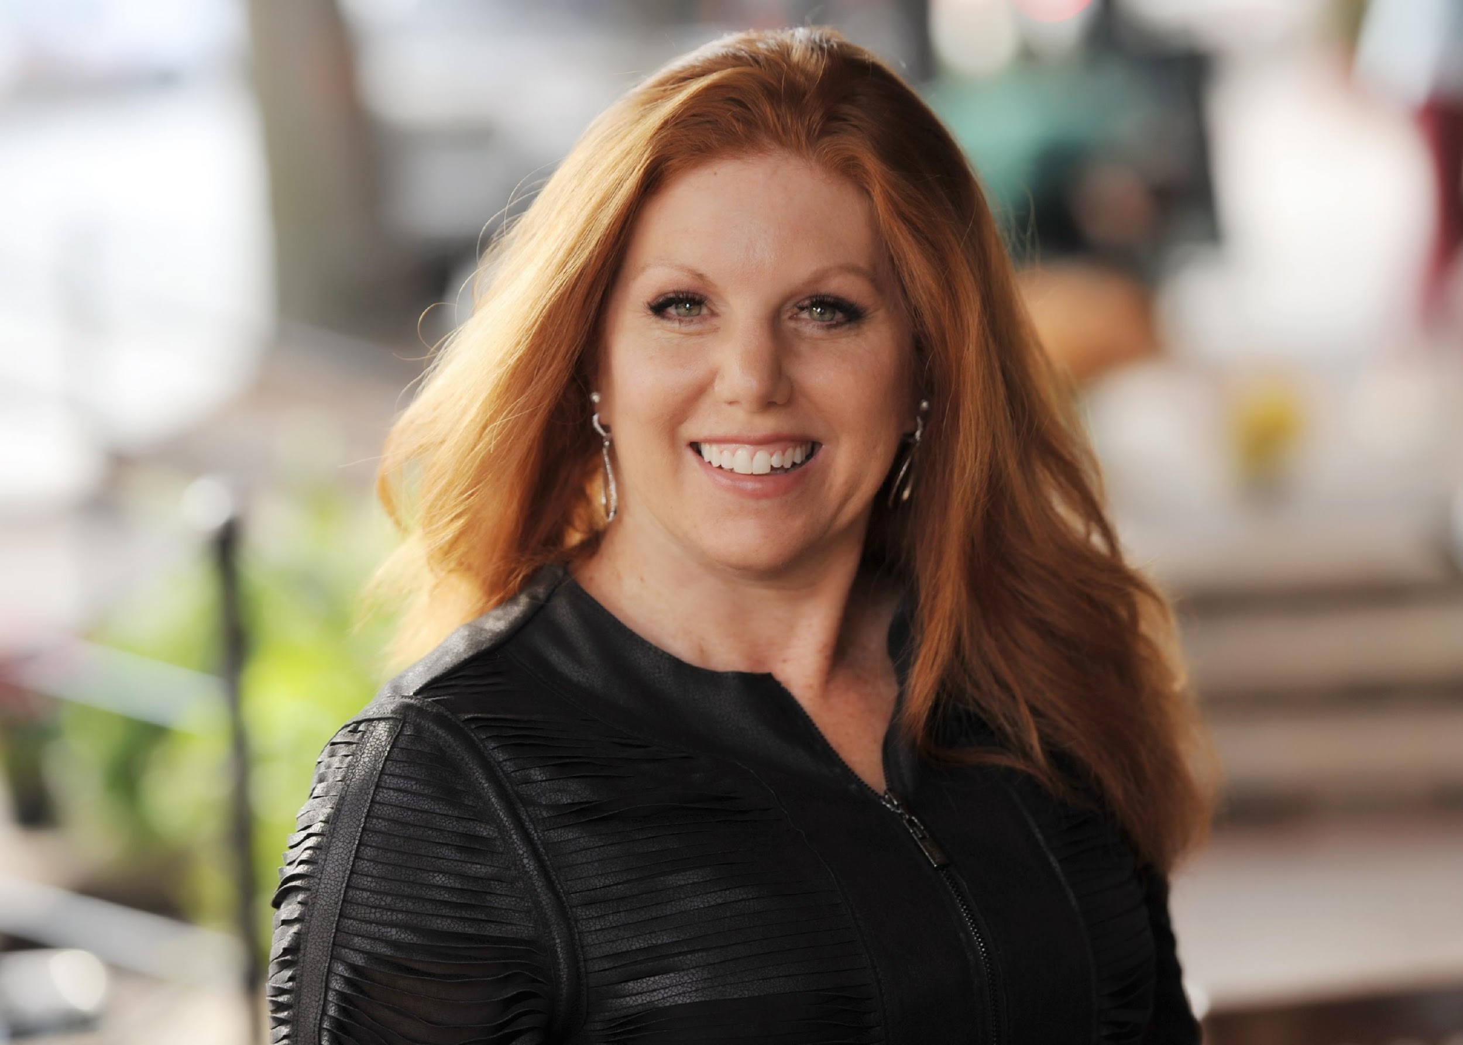
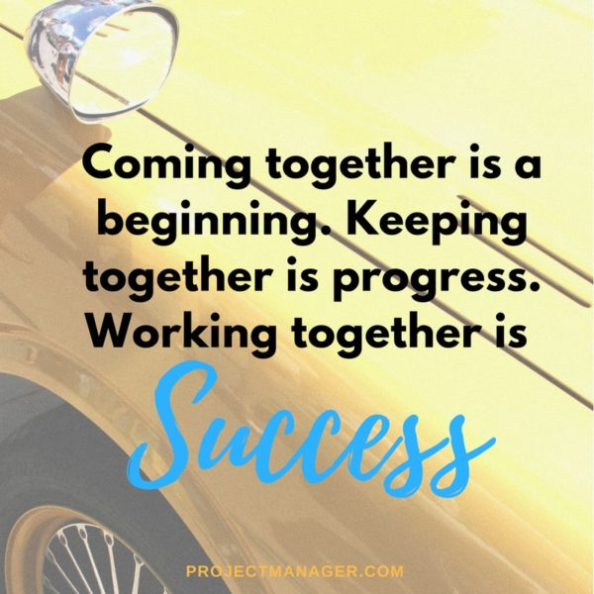
Welcome
Marva Bailer | Strategic Advisor, Executive & Digital Engagement

Slide 3
Today’s Agenda
Topic | Presenter
Welcome & Agenda | Marva Bailer | Strategic Advisor, Executive & Digital Engagement
Air Cover: Thought Leadership Investments for Executive & New Buyer Conversations | Marva Bailer
Backstage of the “Dark Data Report” | Interviewer: Marva Bailer Guests: Tom Stilwell | Senior Director Corporate Communications Tom Peterson | Global Field Strategist
New Pipeline Acceleration: DevOps is a Gold Mine | Andi Mann | Chief Technologist (Top 5 Cloud Experts, Top 50 Cloud Computing Influencers)
Acceleration Play: Data Driven Service Intelligence | Stuart Ainsworth | Specialists Leader - North America
“Getting to the Next Deal”: Humana & FAA Adoption Journey, Next Level of Customer Success | Ines Thornburg | Director of Customer Success, AMER
Wrap-Up: Key Dates, Program Launches, Enablement Content, & Marketing Programs | Marva Bailer
Hosts: Christian Smith | VP, Americas Sales & Marva Bailer | Strategic Advisor, Executive & Digital Engagement
Producer: Sarah Marx | Program Coordinator - Sales Enablement

Slide 4
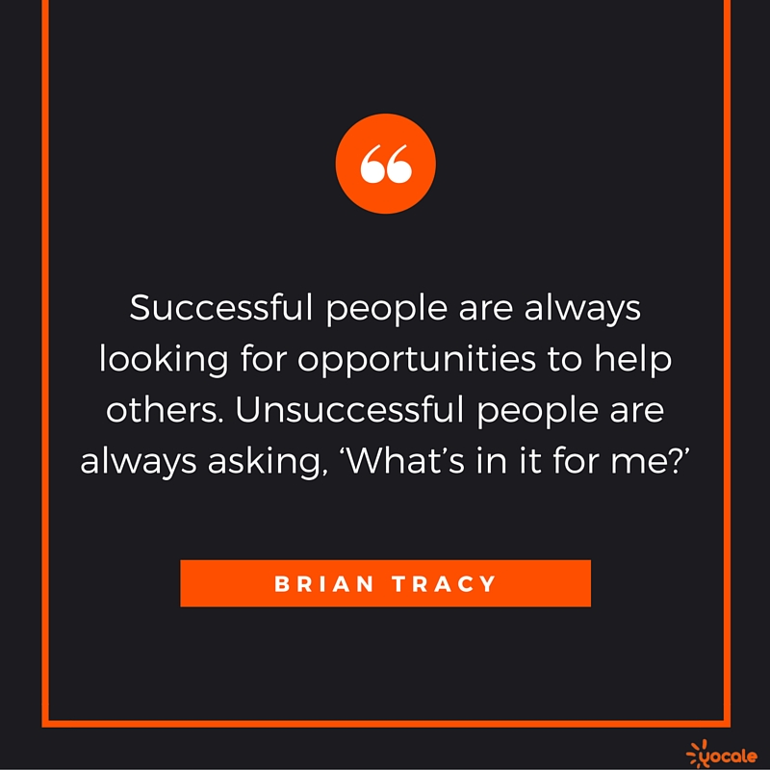

See What Your Customer See’s

Slide 5
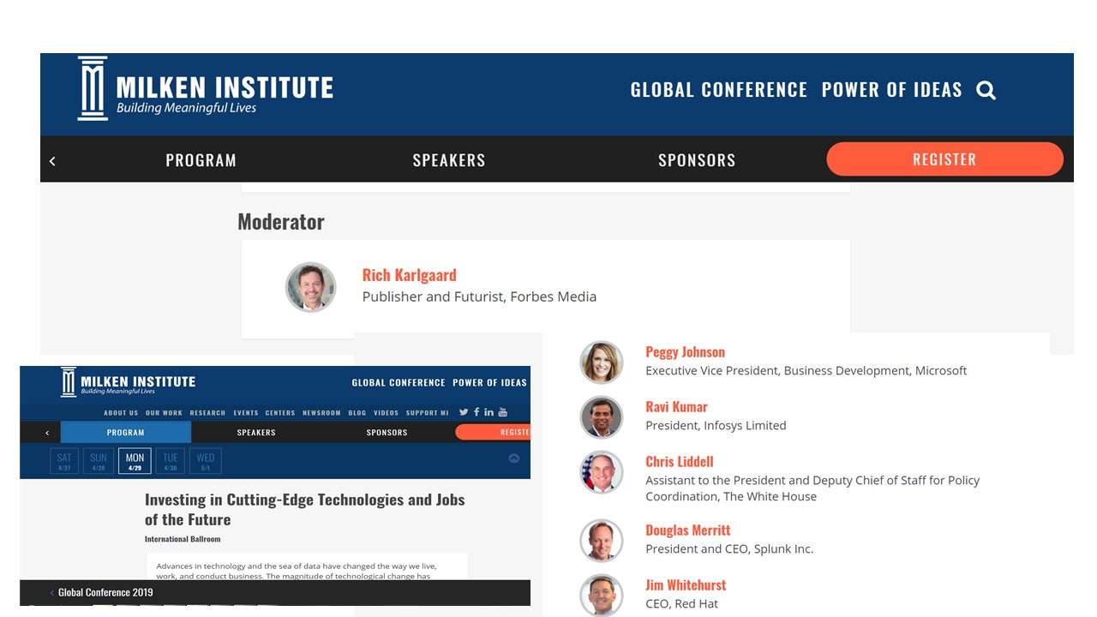
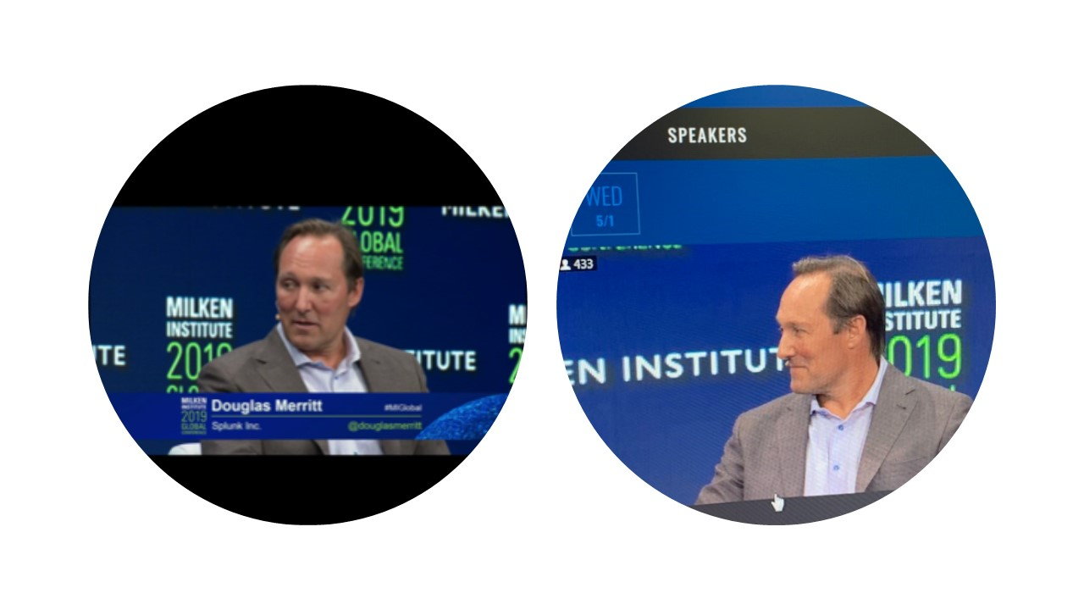
AirCover
Doug presenter at Millen Institute CEO, Hollywood, Govt Officials, Non Profit

Slide 6
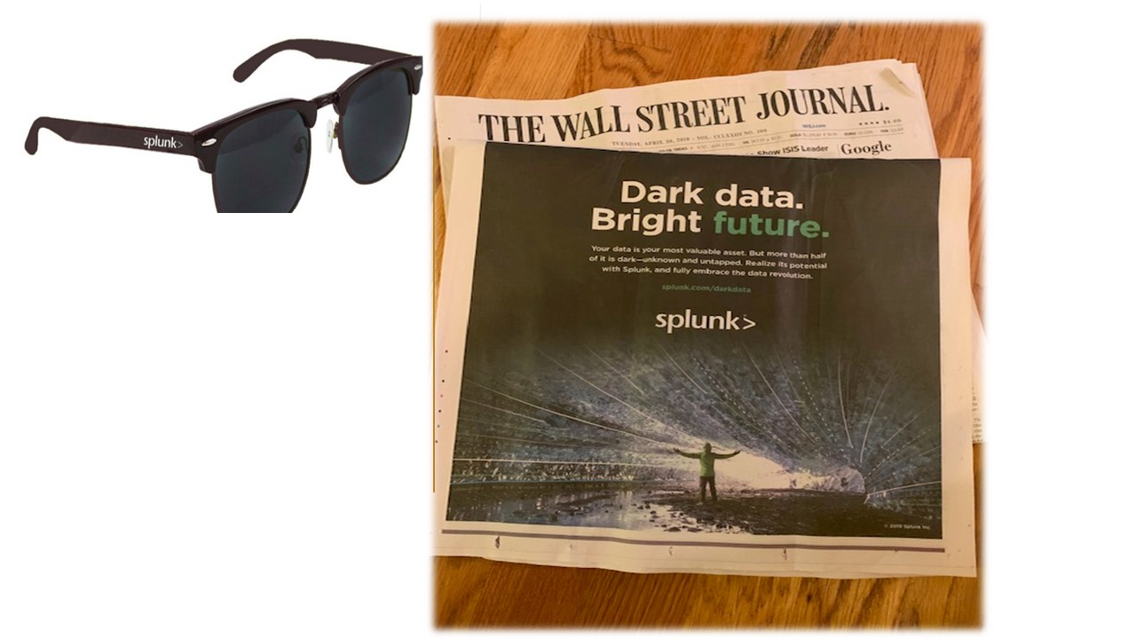
Air Cover- Make it Personal

Slide 7
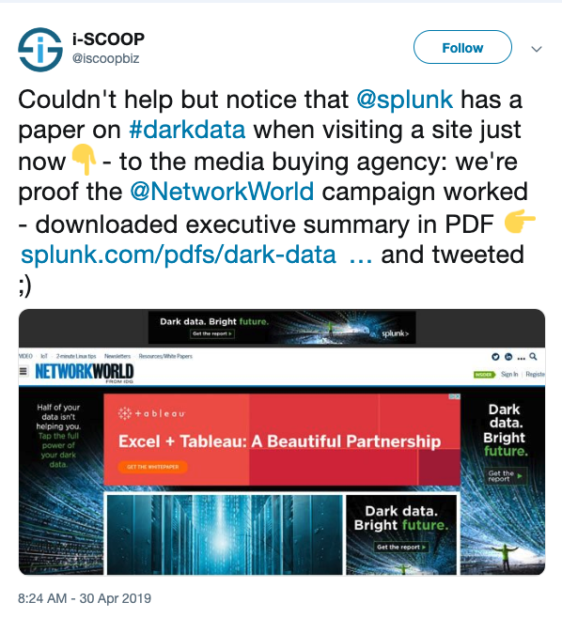
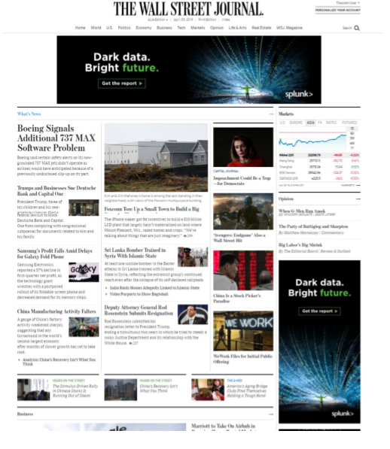
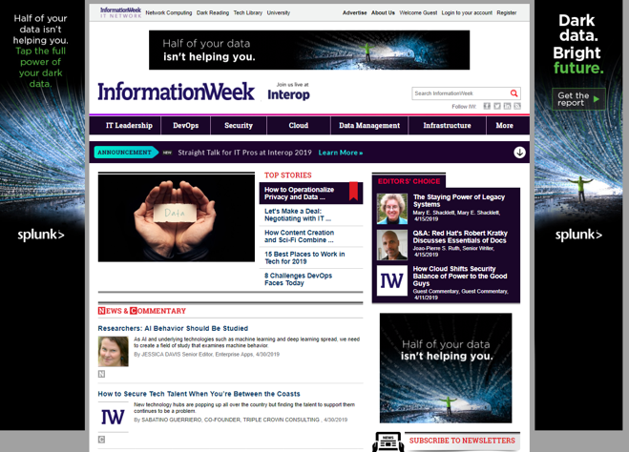
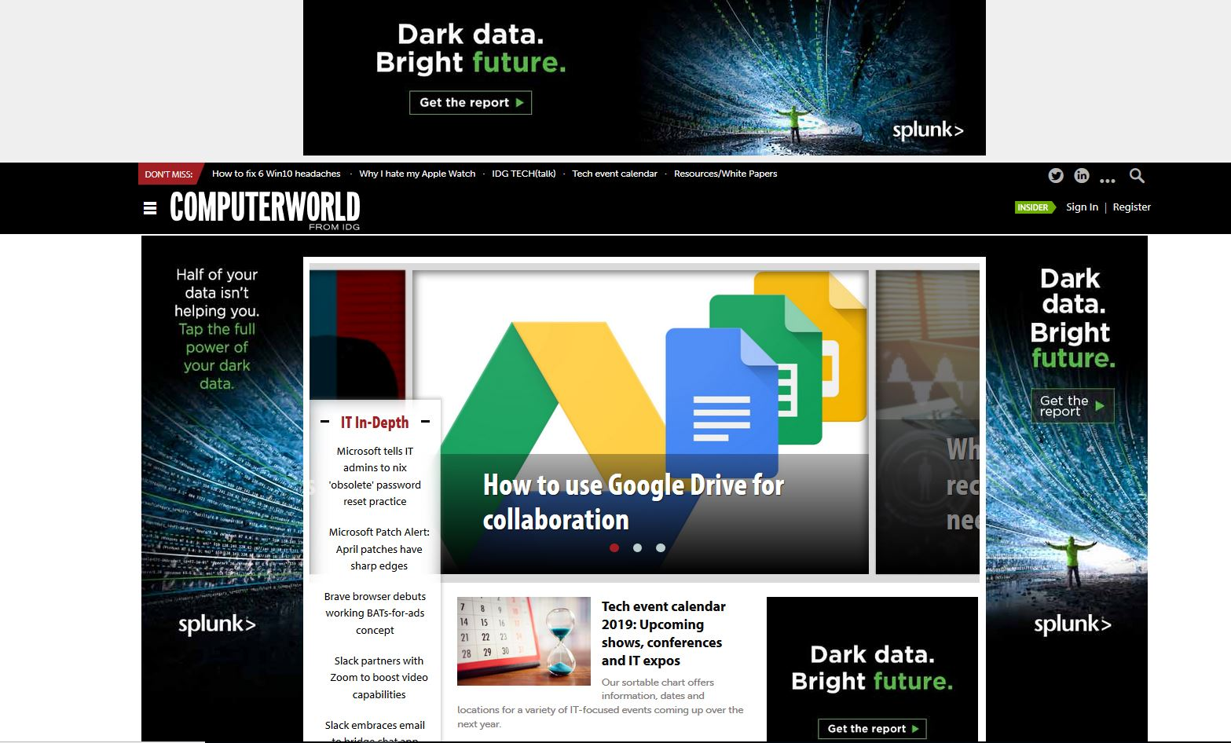
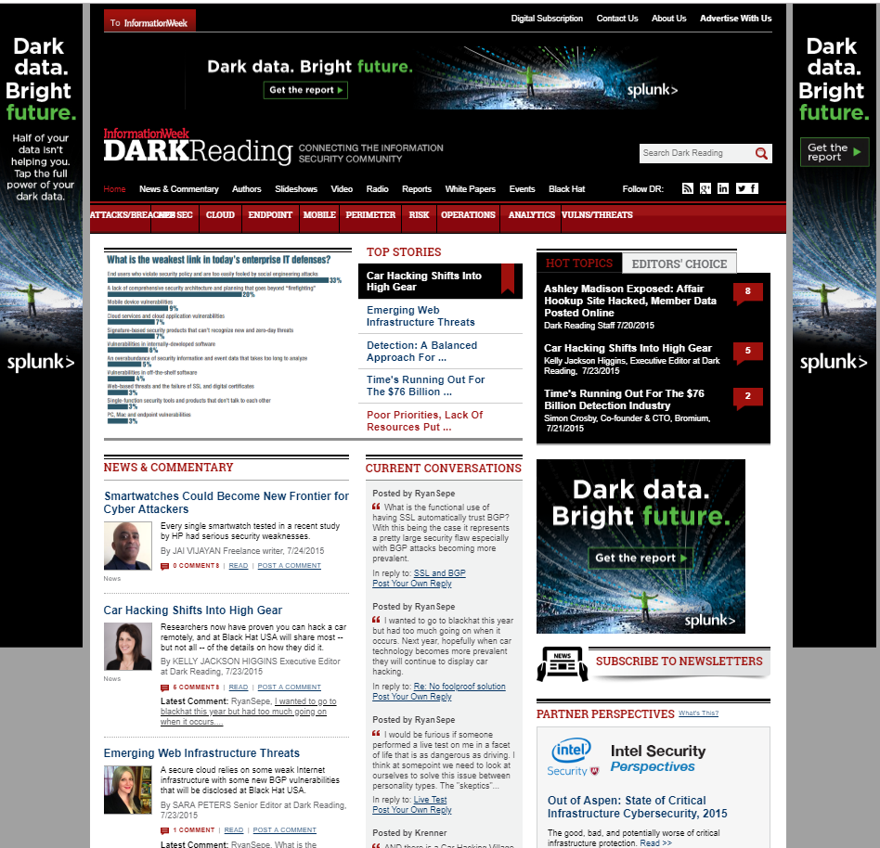
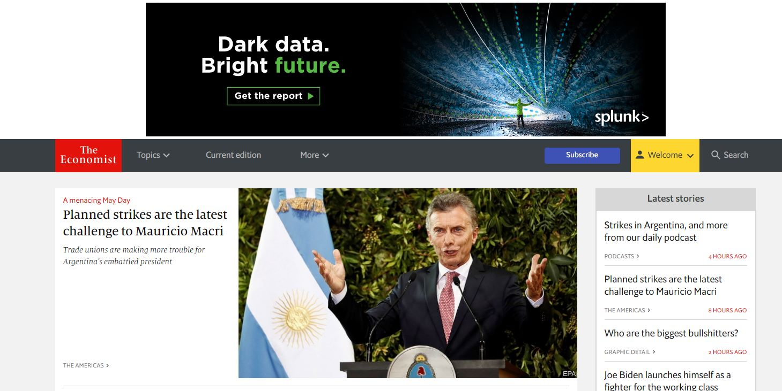
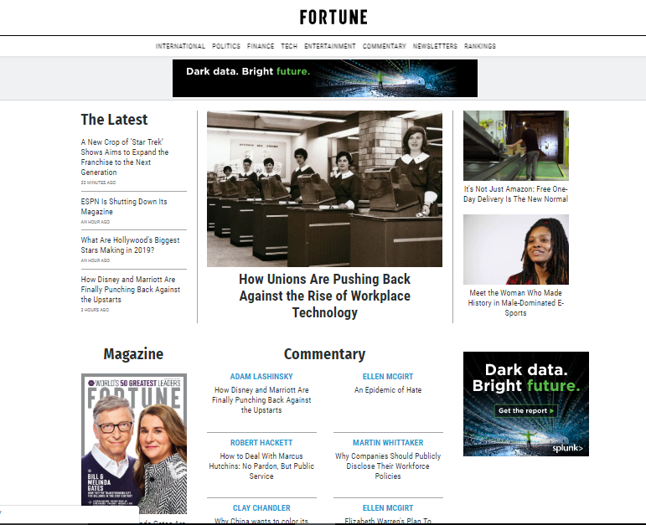
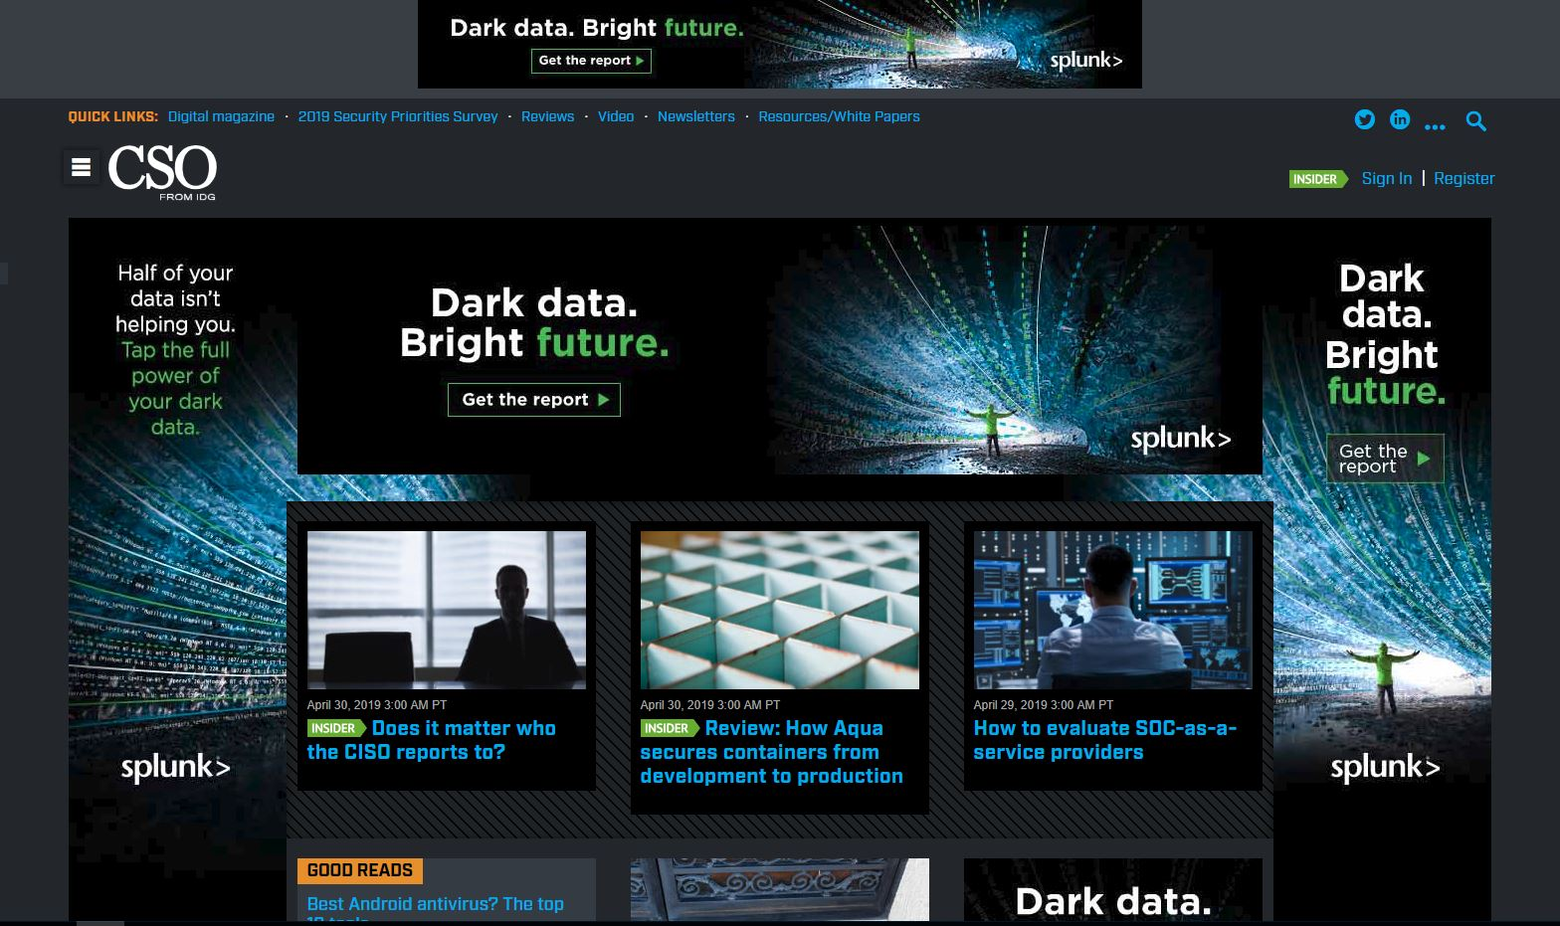















Dark Data – Bright Future Global Launch
APRIL 30 GLOBAL SITE TAKEOVERS
Notes:
Social media pick up shows banner ads work! (15k followers!!) This campaign will run thru June 7. In addition to pointing to the campaign page on our website, we will have dedicated banners offering the report directly for download to drive engagement and leads.

Slide 8
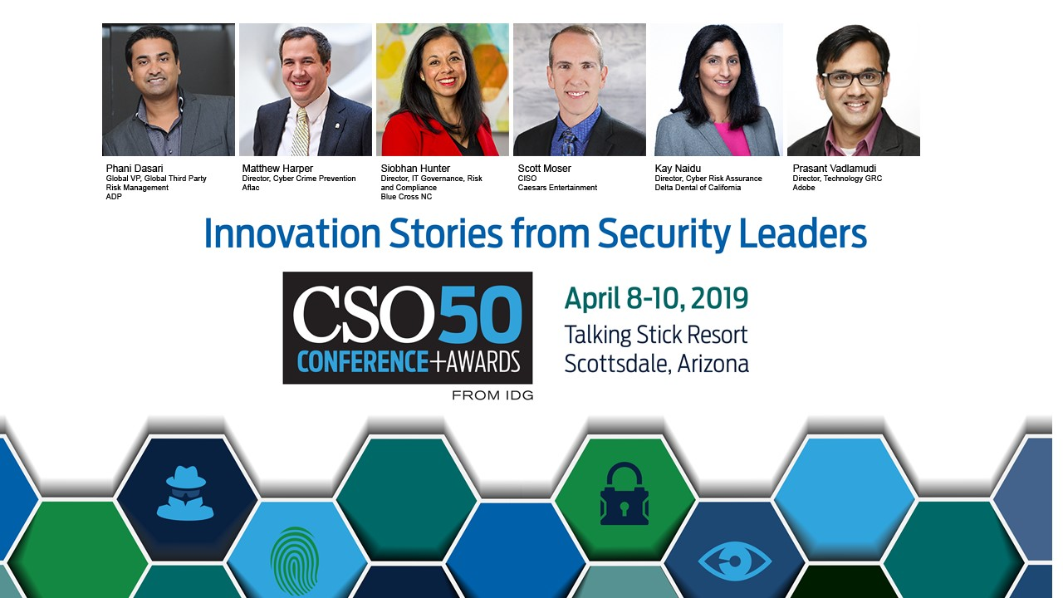
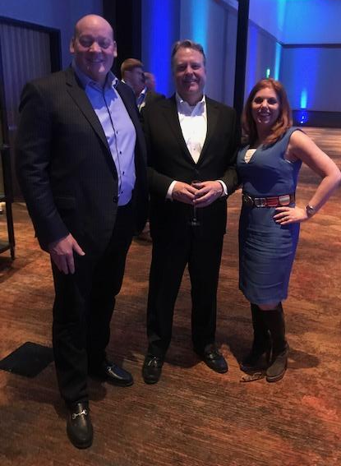
Credibility by Association- CSO Relationship Leverage
Key Alignment and Affinity with CSO/ CIO Publication

Slide 9
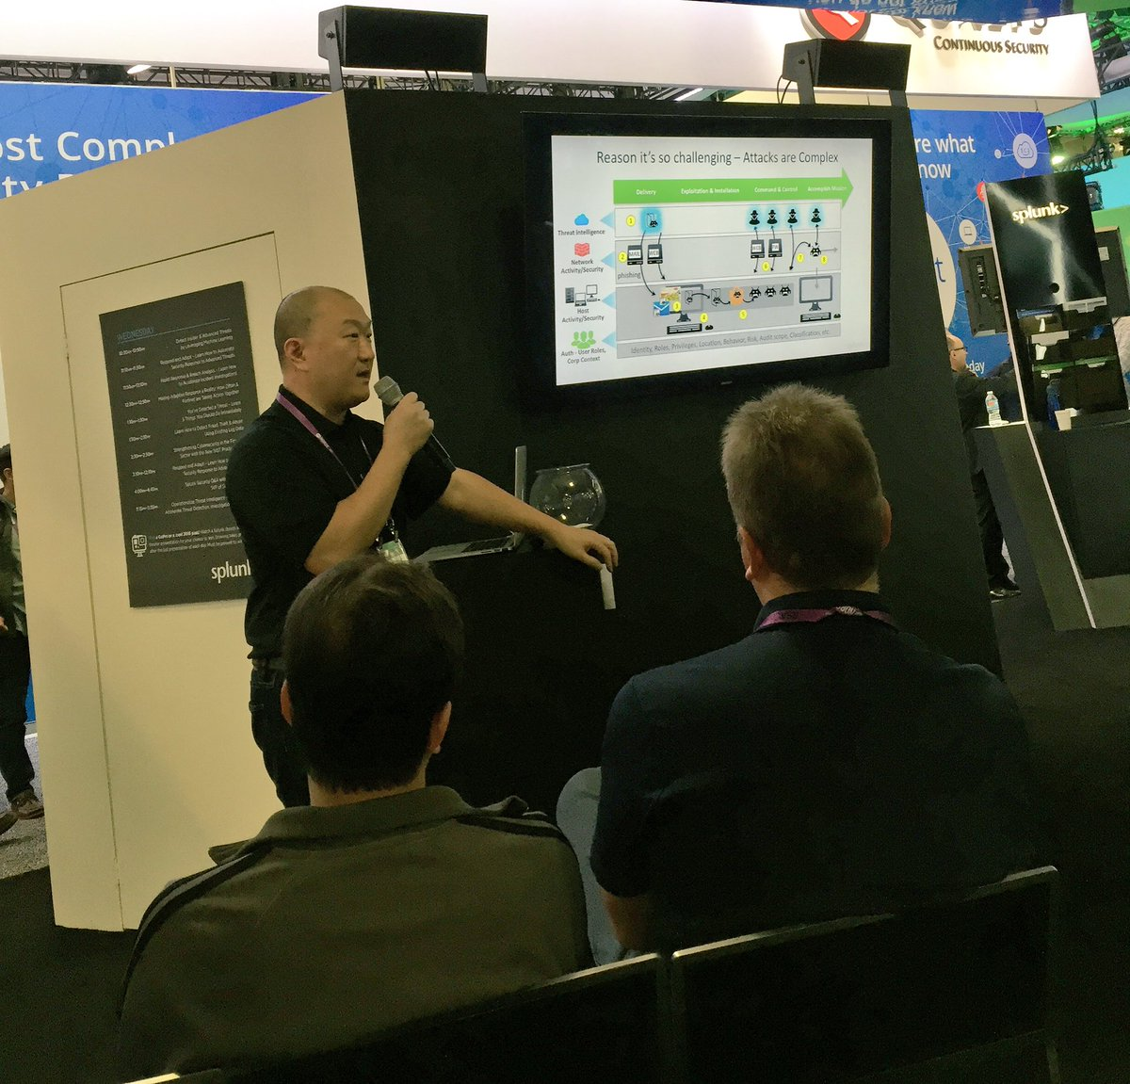
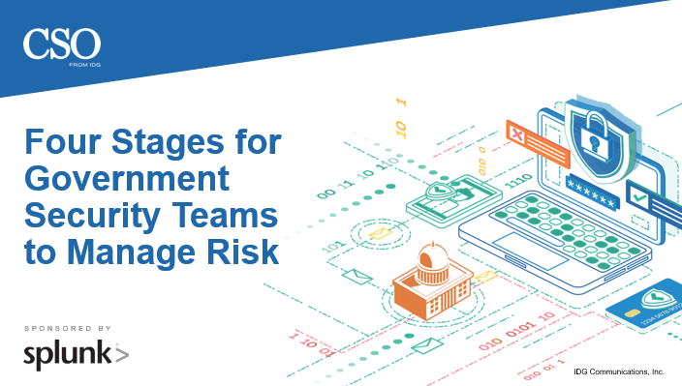
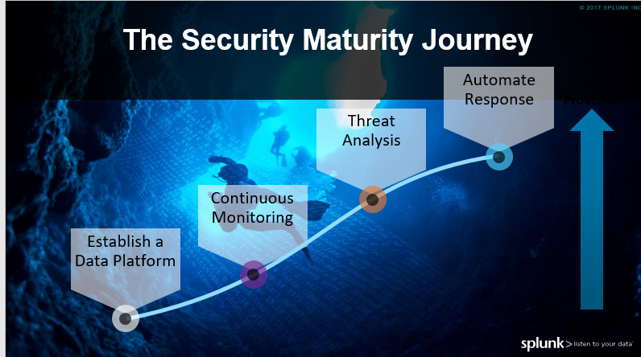

What’s Next? CSO (IDG) Custom Content
Jae Lee speaking for Splunk
CSO moderated, panel type webcast featuring CISO customer: University of Texas Austin
Featuring Splunk’s security maturity journey
Custom exec brief featuring 4 steps for government security
Notes:
PBST GTM looking to drive higher level (director, exec) engagement and leads in FY20

Slide 10
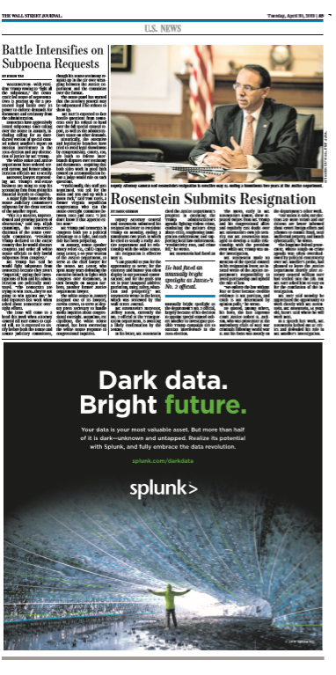
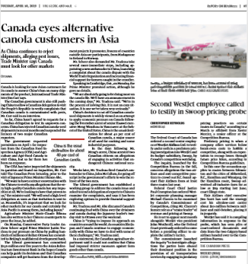
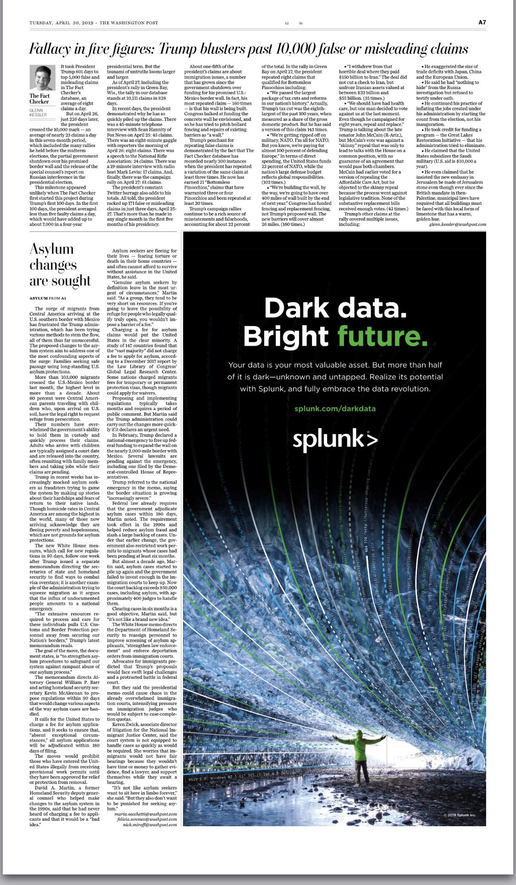



Dark Data – Bright Future Global Launch
NORTH AMERICA PRINT ADS
Notes:
We also ran full print ads in Financial Times which reaches across Europe, Les Echos in France, and Financial Review in Australia

Slide 11
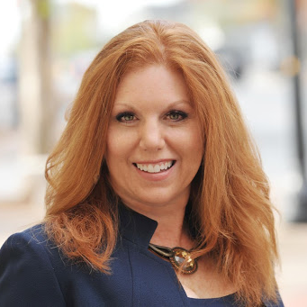
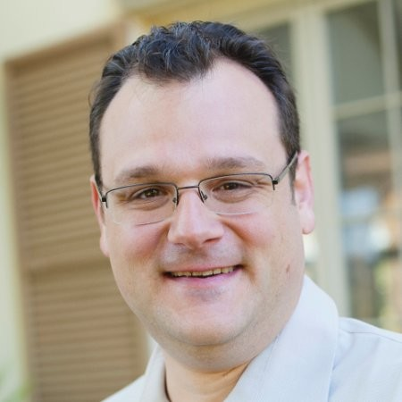

Backstage of the
“Dark Data Report”
Marva Bailer | Strategic Advisor, Executive & Digital Engagement
Tom Stilwell | Senior Director, Corporate Communications
Tom Peterson | Global Field Strategist
Notes:
· Shared Values: Leveraging Workforce Development Non-Profit Initiatives
· Shared Values: Leveraging Workforce Development Non-Profit Initiatives

Slide 12
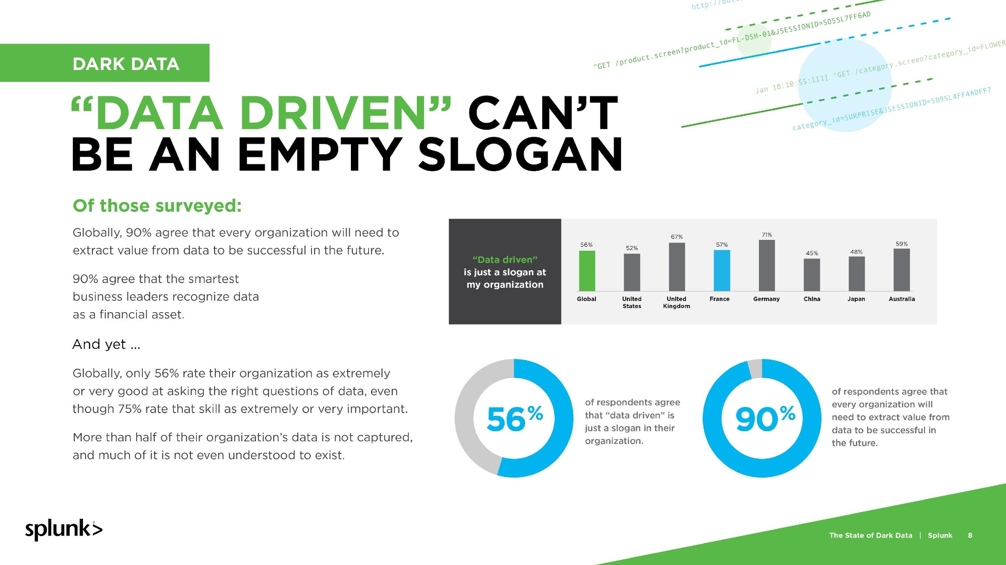

Slide 13
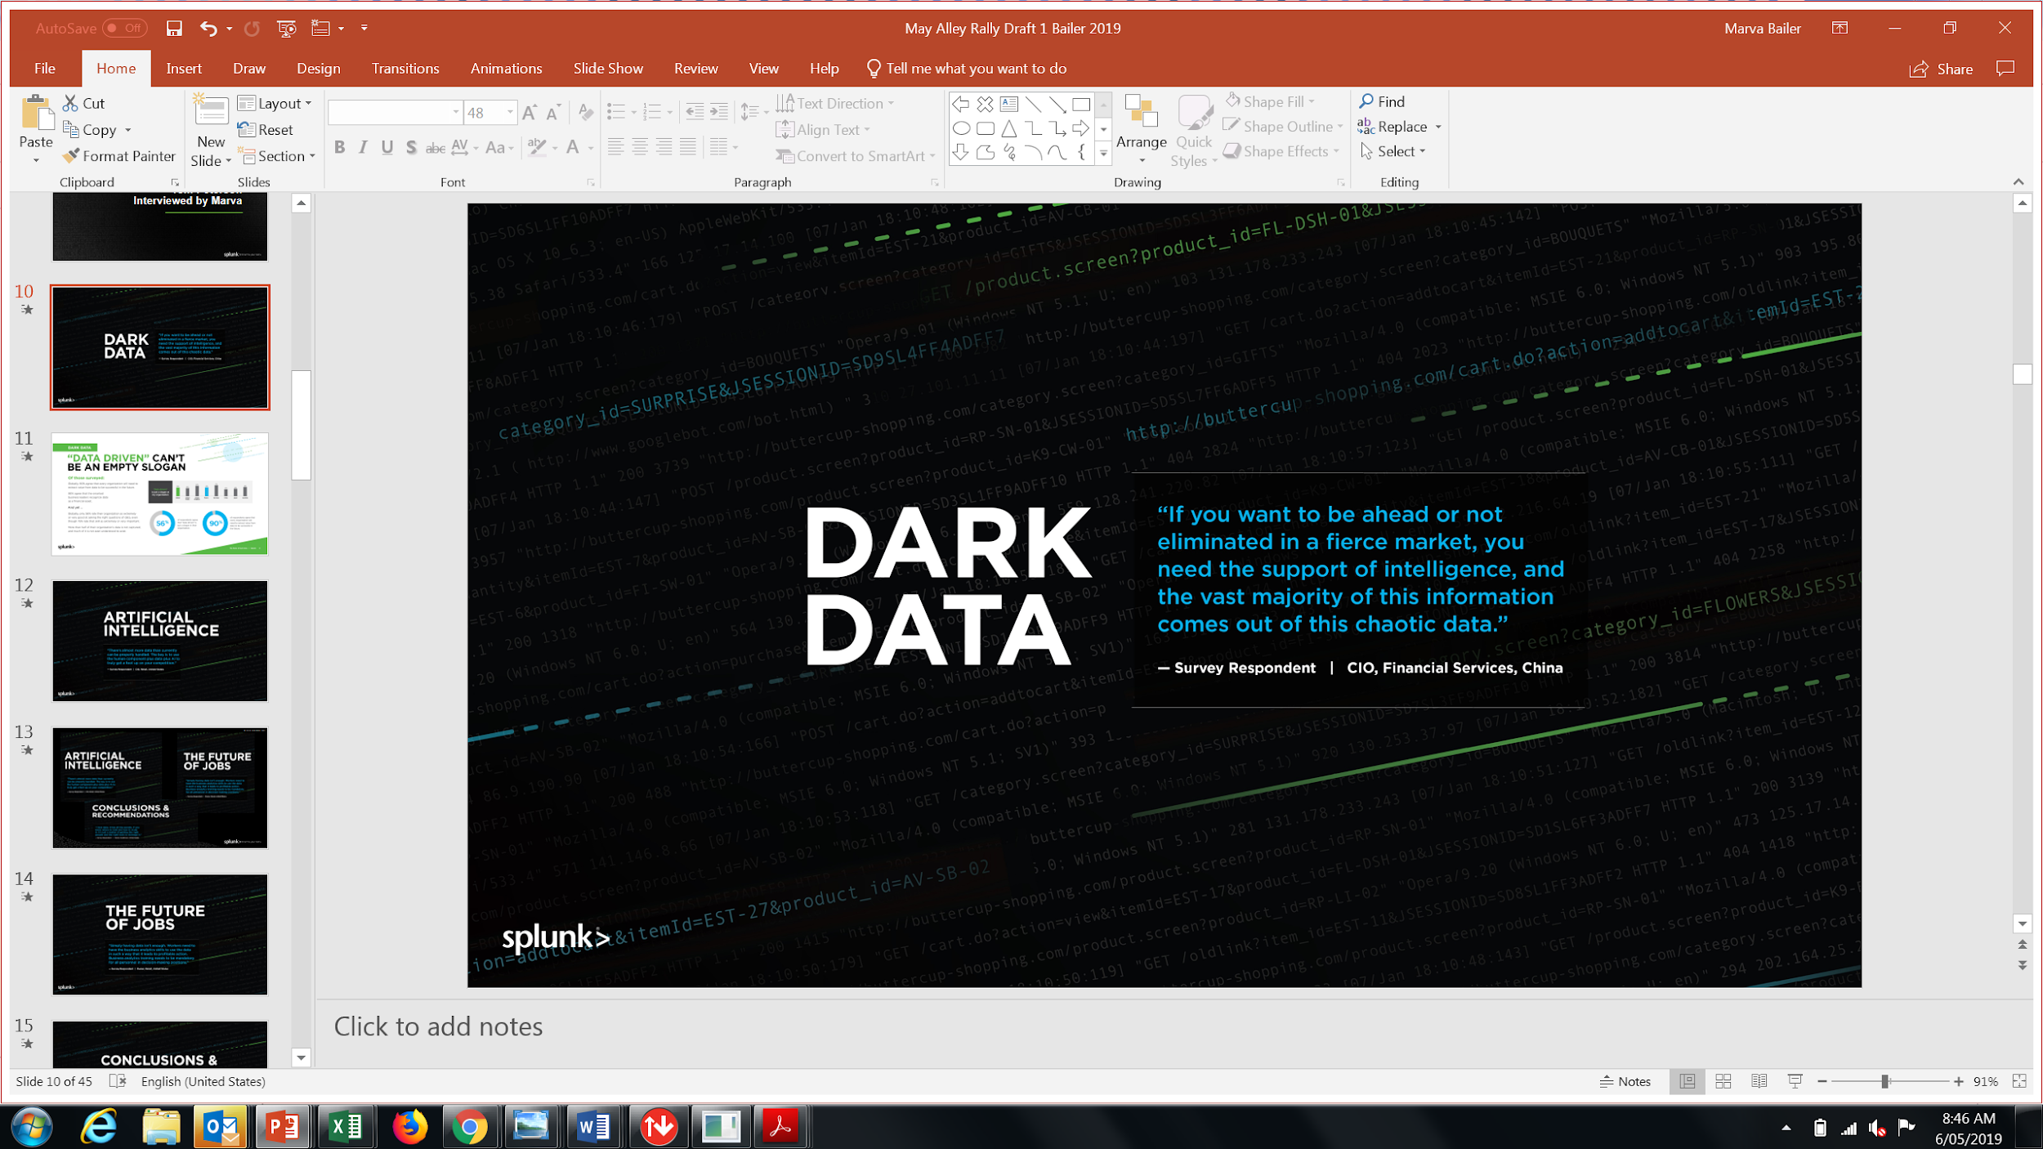
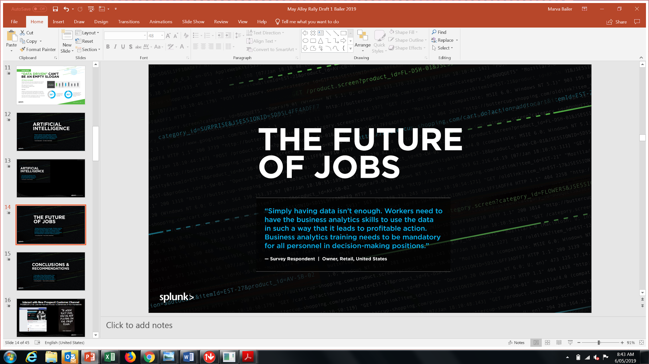
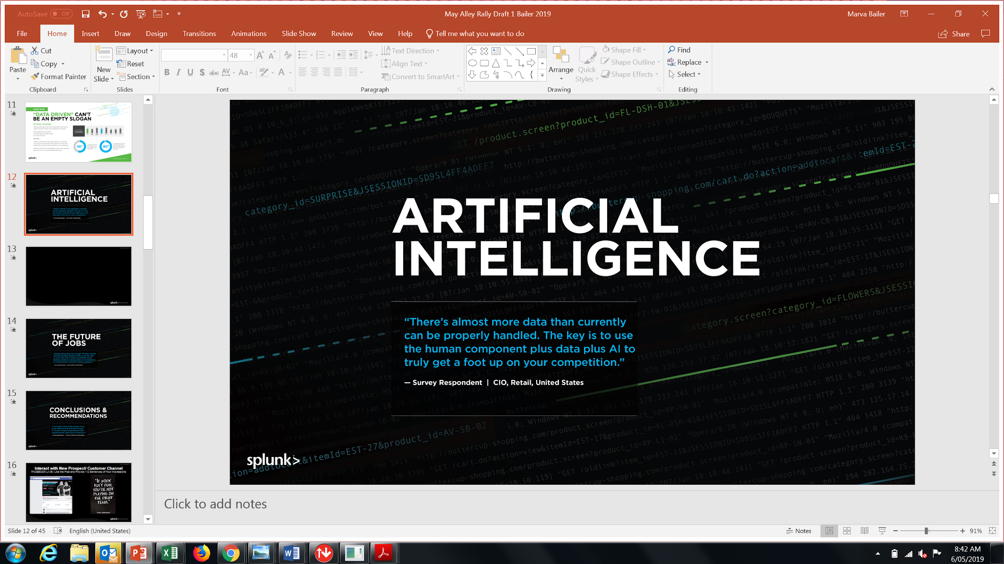
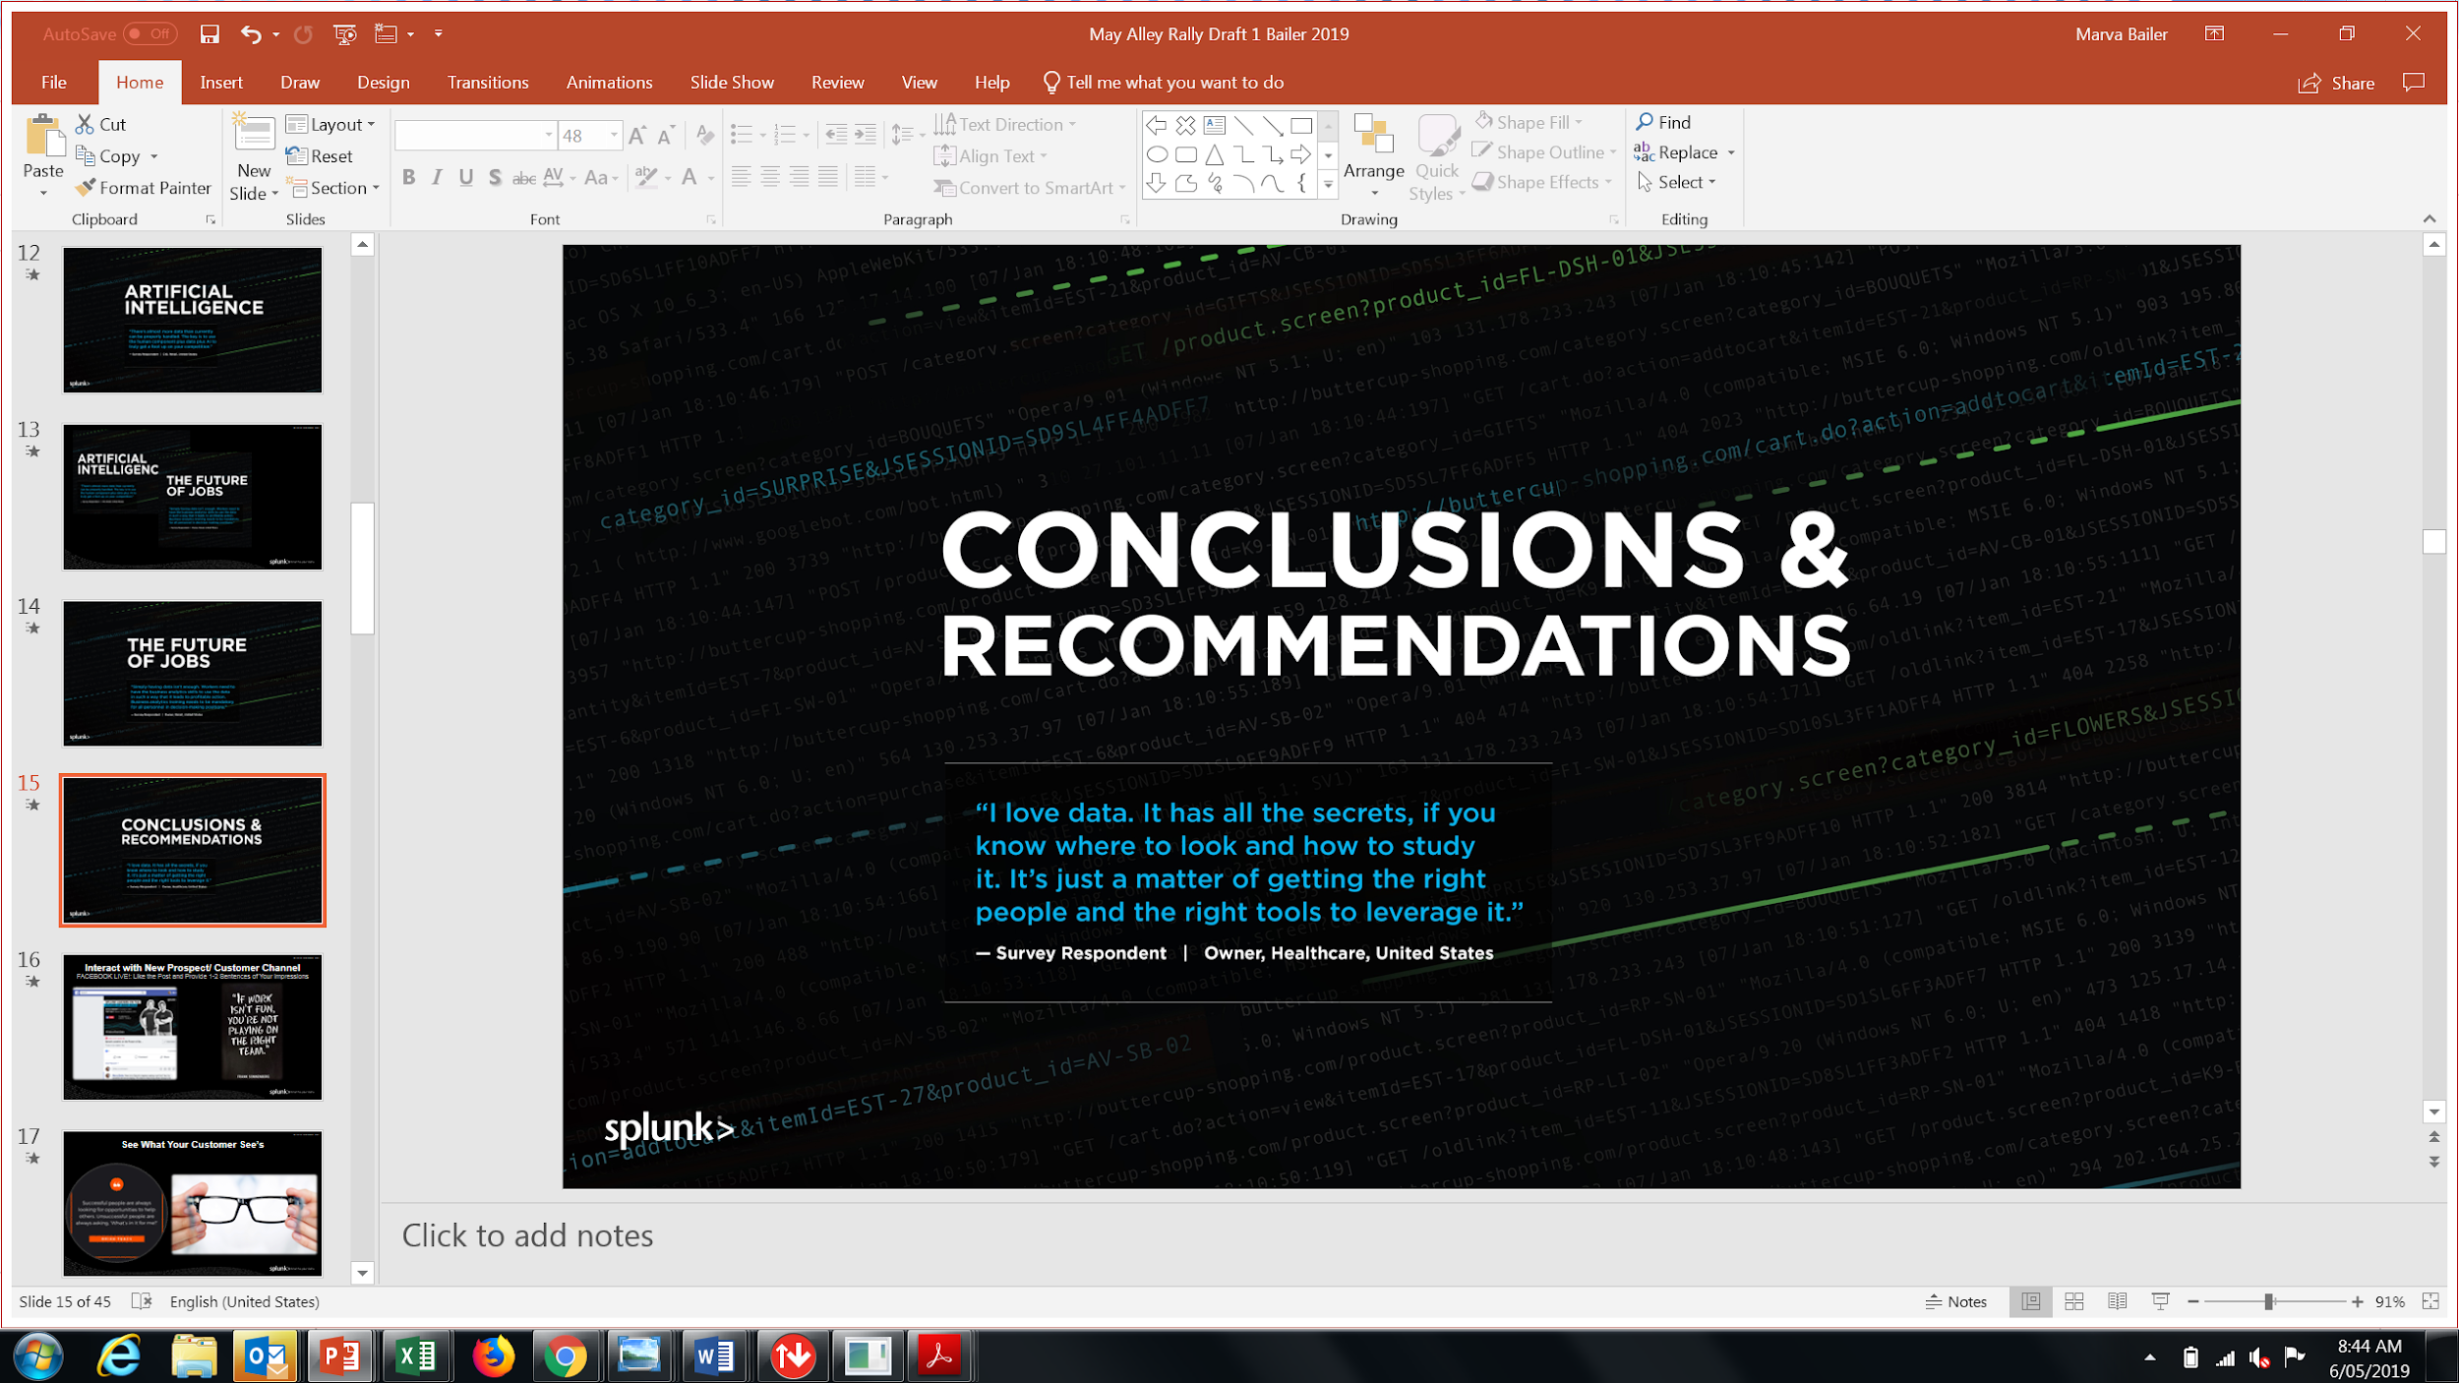

Slide 14
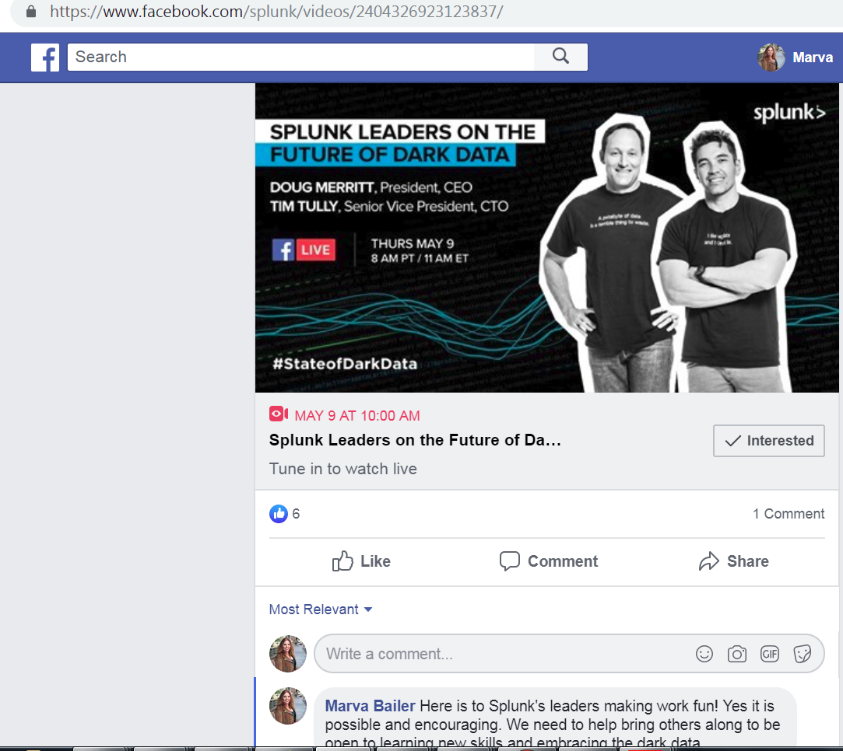


Interact with New Prospect/ Customer Channel
FACEBOOK LIVE This Thursday at 8am PT
Like the Post and Provide 1-2 Sentences of Your impressions

Slide 15
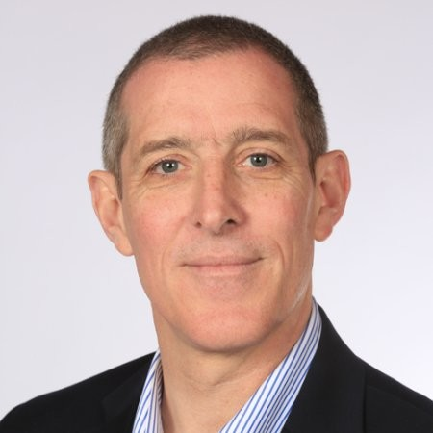

New Pipeline Acceleration:
DevOps is a Gold Mine
Andi Mann | Chief Technologist
Top 5 Cloud Experts
Top 50 Cloud Computing Influencers

Slide 16
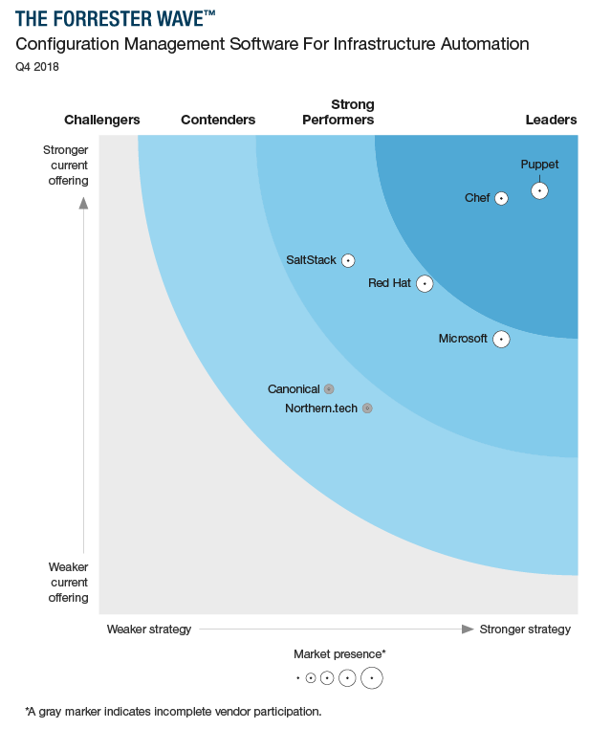

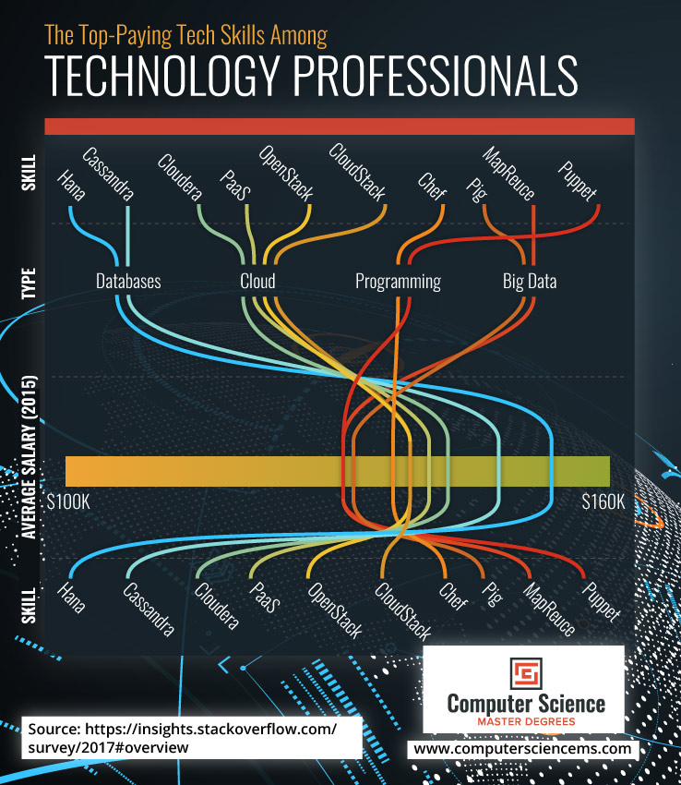
Top Leader in Configuration Management Top Tech Skill In Demand
Notes:
Talking points:Source: Forrester Research, Configuration Management Software for Infrastructure Automation, Q4 2018. Download at puppet.com
Puppet is the leader in configuration management.
For the past two years in a row, we’ve been named the overall leader in Configuration Management Software Wave by Forrester.
Puppet earned the highest scores of all vendors evaluated in the current offering category, as well as the strategy category.
Puppet also earned the highest possible scores in the deployment, monitoring and governance, community support, market approach, consulting, training and support, and innovation in pricing criteria.
We exist to partner with companies like yours achieve DevOps success faster.
If you’d like to read the report, please visit puppet.com to download a free copy. (https://puppet.com/resources/analyst-report/forrester-wave-configuration-management-software-infrastructure)
TRANSITION: In addition to analyst recommendations, there are many more reasons IT organizations choose to partner with us.
Stackflow Survey

Slide 17
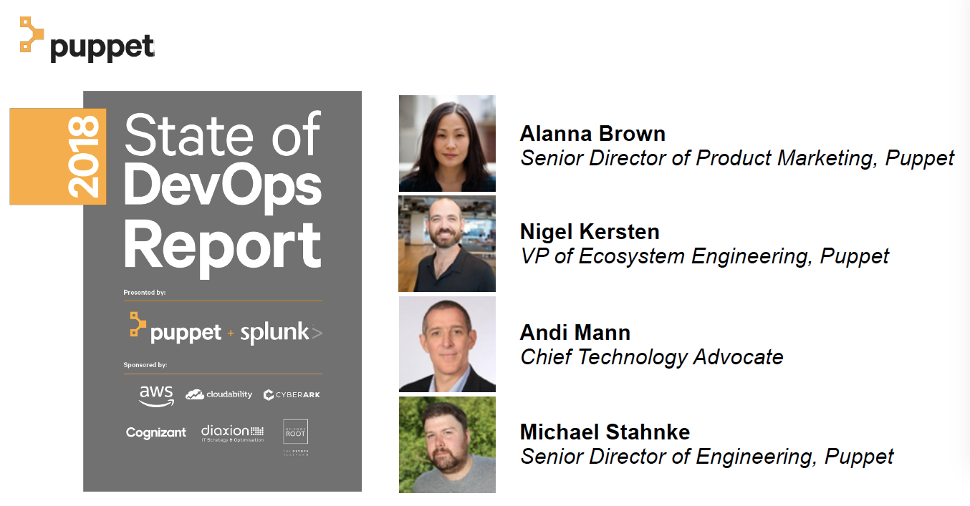
World Class Thought Leadership in DevOps
, Splunk

Slide 18
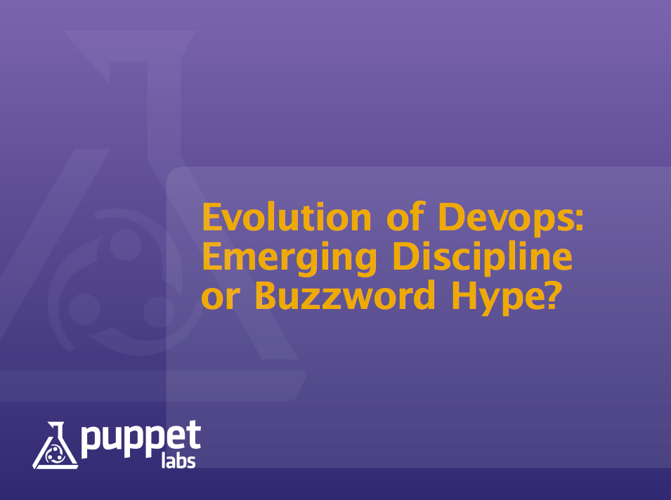
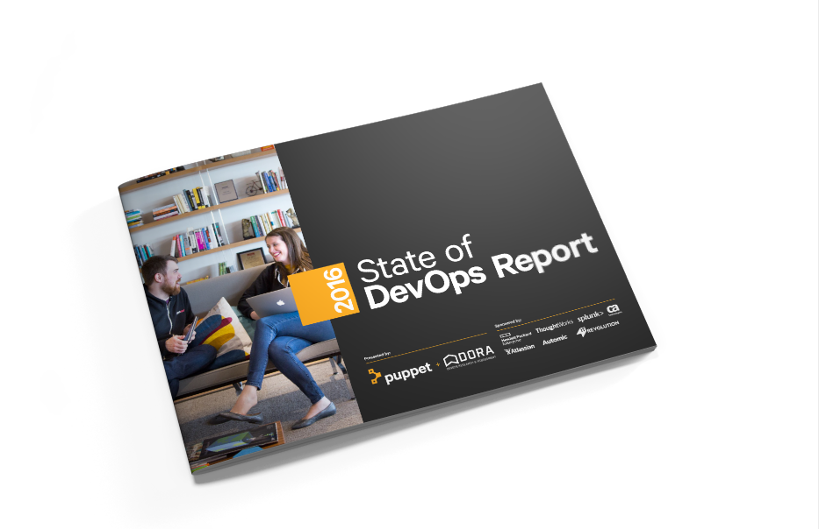
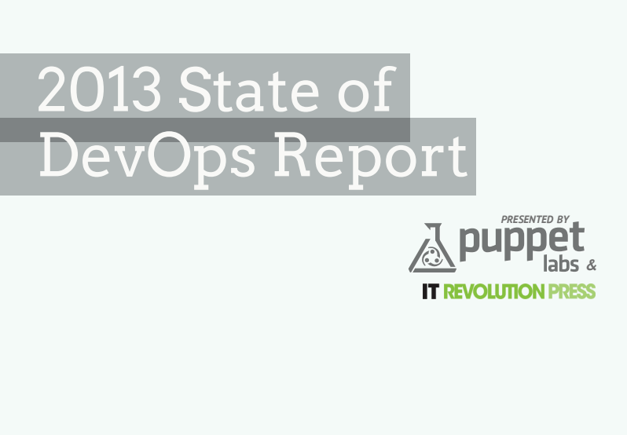
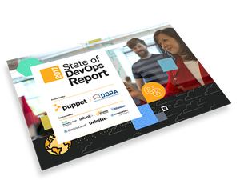
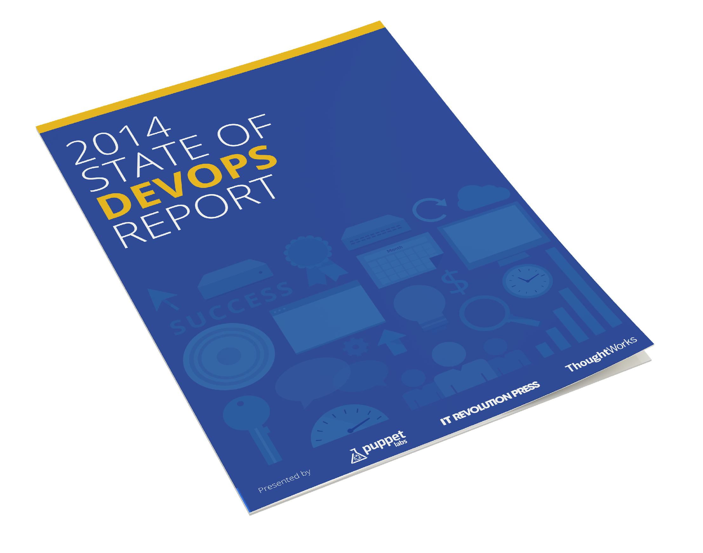
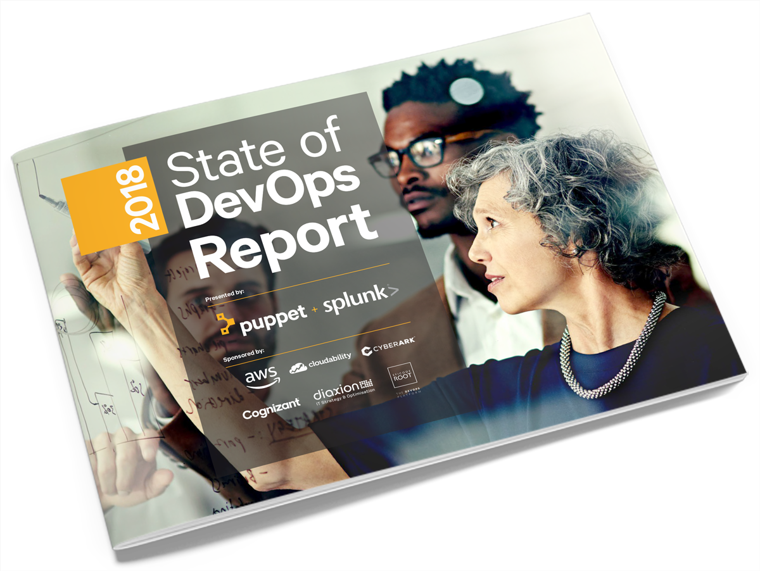
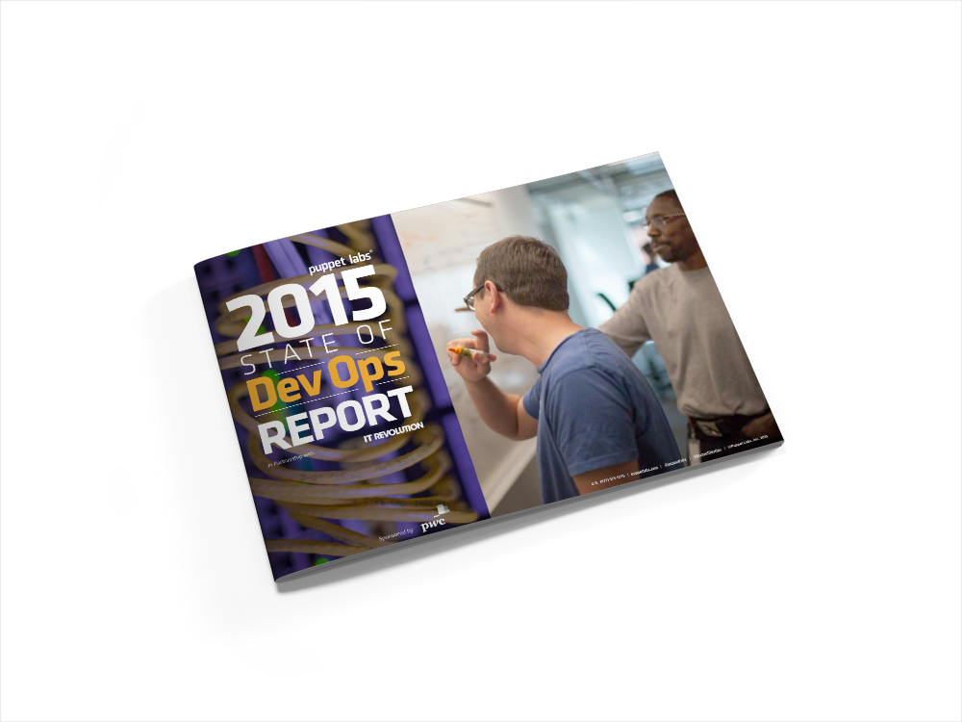
Market Maturation: History of the State of DevOps Report
2012:
What is devops?
2016:
Shifting left.
2013:
DevOps adoption is accelerating.
2017:
DevOps works for all organizations.
2014:
Holy cow! DevOps works!
2018: 5 Stages of DevOps Journey.
2015:
IT goes lean.

Slide 19
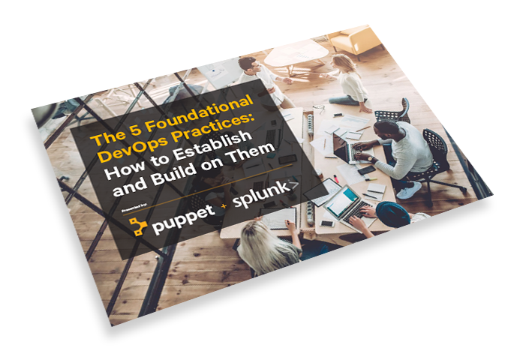
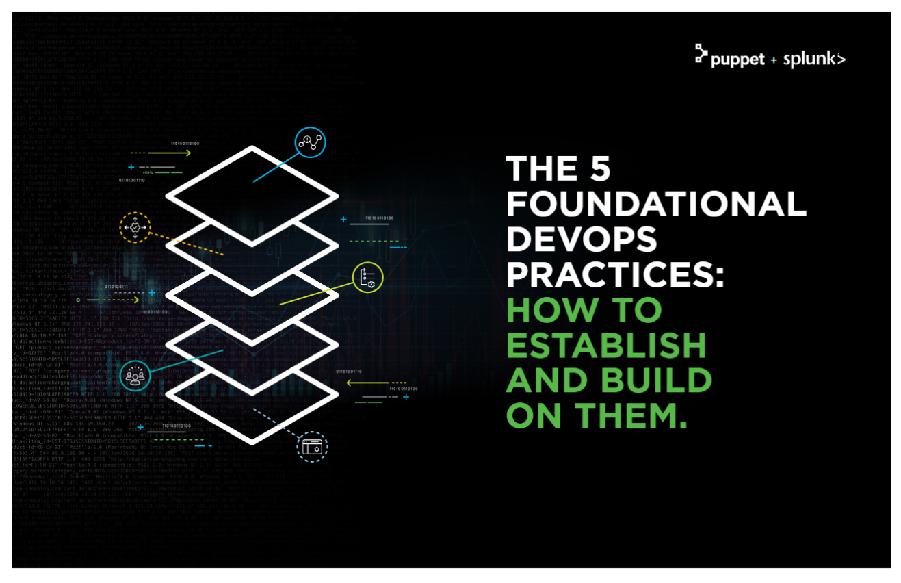

Bring Report to Life w Prospects/ Customers
12 City Workshop: Benchmarking The 5 Foundational DevOps Practices
“Andi Mann provided so much great content for the main report….that we created a second paper!”
The 5 Foundational DevOps Practices: How to Establish and Build on Them

Slide 20
Puppet Anchor Accounts Per City- June/ July Amer
Opportunity to Reach new SPLUNK Buyers/ Personas
LinkedIn - San Jose-PayPal - San Jose ( note Citrix on FL List)
Citibank – NYC-Credit Suisse – NYC-Morgan Stanley – NY
State Street – Boston-Fidelity – Boston-Putnam – Boston-MassMutual – Boston- Iron Mountain (two places)
Nintendo – Seattle-Expedia – Seattle-Boeing - Seattle
Campbell Soup - King of Prussia
Comcast - King of Prussia
Iron Mountain - Boston/King of Prussia
Nationwide – Columbus-Cardinal Health – Columbus-DSW - Columbus
Molina Health – Irvine-Pacific Health – Irvine-First American Financial Corp – Irvine
Siemens -NCR – Atlanta-CHOA – Atlanta-RaceTrac - Atlanta
Palm Beach County – Miami-Citrix – Miami-World Fuel – Miami-Telefonica - Miami
Paylocity – Chicago-HERE – Chicago
Atrium Health – Charlotte-Novant Health – Charlotte-Lending Tree - Charlotte
DIA - Federal (Columbia/Tysons)-NSA - Federal (Columbia/Tysons)-MCSC - Federal (Columbia/Tysons) -Secret Service - Federal (Columbia/Tysons) -FAA - Federal (Columbia/Tysons

Slide 21
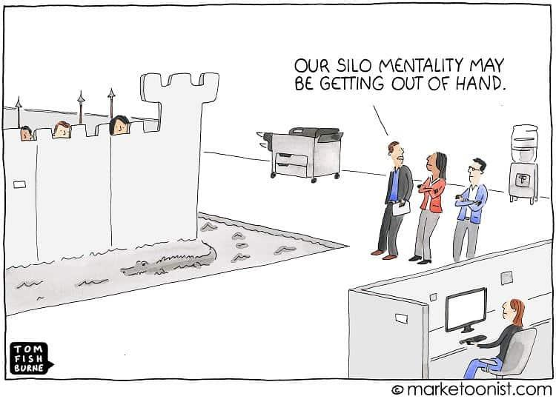
See What Your Customer See’s

Slide 22
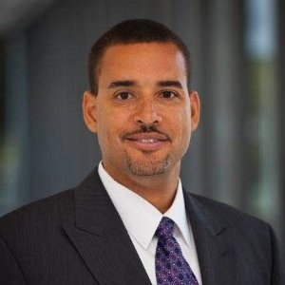
Acceleration Play:
Data Driven Service Intelligence
Stuart Ainsworth | Specialist Leader - North America

Slide 23
CIO
LANDSCAPE
VP Ops
VP Apps / LoB
The CIO represents the entire picture and positioning
Each buyer has a distinctly different purpose for the business and therefore different metrics and goals
Ops tend to be seasoned buyers and are under pressure to remove cost and do more with less, therefore can make a more defined land
VPApps role doesn’t always exist in each customer - likely the customer will have multiple service/LoB owners each “owning” 1 or more services
$$$ COST SAVING - “Run” the business
$$$ VALUE CREATION - “Change” the business
METRICS - Cost saving, FTE redeployment/reduction, tools rationalization, incident/noise reduction, capacity optimization, MTTR reduction
METRICS - Customer experience, conversion, new value streams, new customer acquisition, business impact/lost opportunity
USE CASES - Infrastructure troubleshooting & monitoring, capacity management, cloud operations, container monitoring
USE CASES - Application troubleshooting & monitoring, service insights, release analytics, customer experience monitoring
TOOLS - Nagios, MS SCOM, Data Dog, SignalFX, Dynatrace, Big Panda, IBM Tivoli, CA Service Operations Insight, BMC Event Management, HP Openview, Moogsoft, HP SiteScope, Solarwinds, vCenter Operations …∞
TOOLS - Dynatrace, AppDynamics, New Relic, Interlink, IBM Netcool/Omnibus, Riverbed, SignalFX, DataDog….
Making IT Markets Solutions Easier to Sell
Define 2 prescriptive entry points that are highly focused at each buyer persona
Reorganize and simplify existing sales play assets and create more focused motions and assets
Give the field an efficient and focused way to prospect pipeline and a quick way to qualify opportunities “In” or “Out”

Slide 24
CIO
SALES RESOURCES
VP Ops
VP Apps / LoB
$$$ COST SAVING - “Run” the business
$$$ VALUE CREATION - “Change” the business
Aligned and focused to needs of buying personas
Remove complexity and reduce effort
Disruptive approach to accelerate and expand opportunities
Persona Guides
Persona Guides
NEW
Sales Motions
Replacement/Modernization Workshop
Legacy Replacement Campaign
Streamlined Data Driven Service Intelligence
NEW
NEW
NewOps Autobahn
Splunk Business Flow Selling Motion
NEW
NEW
4. Prediction & Improvement
3. Business Insights
2. Operational Visibility
1. Search & Monitor
ACT
ANALYZE
MONITOR
INVESTIGATE

Slide 25
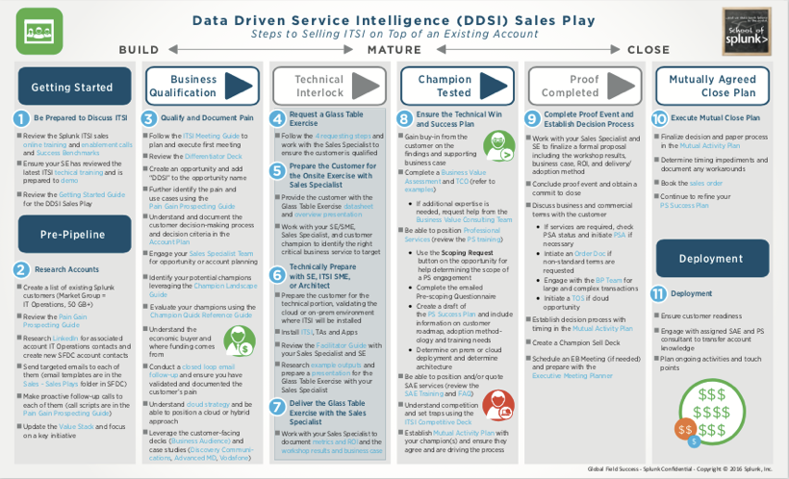
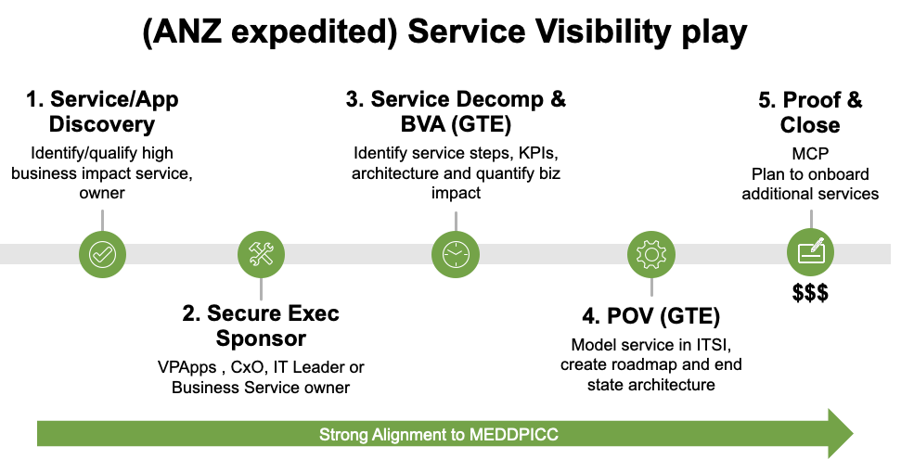
Simplify and Streamline Sales Plays
Streamlined Service Visibility Play
50+ step current process

Slide 26
CIO
PRODUCTS
VP Ops
VP Apps / LoB
New releases with tighter integration
Developing into an integrated suite for the New Operations Center
-$$$ COST SAVING - “Run” the business
+$$$ VALUE CREATION - “Change” the business
splunk> Enterprise
VictorOps
NEW RELEASE
Phantom
NEW PRODUCT
splunk> App for Infra (SAI)
splunk> Business Flow
NEW RELEASE
ITSI
NEW RELEASE
splunk> IT Essentials
4. Prediction & Improvement
3. Business Insights
2. Operational Visibility
1. Search & Monitor
ACT
ANALYZE
MONITOR
INVESTIGATE

Slide 27
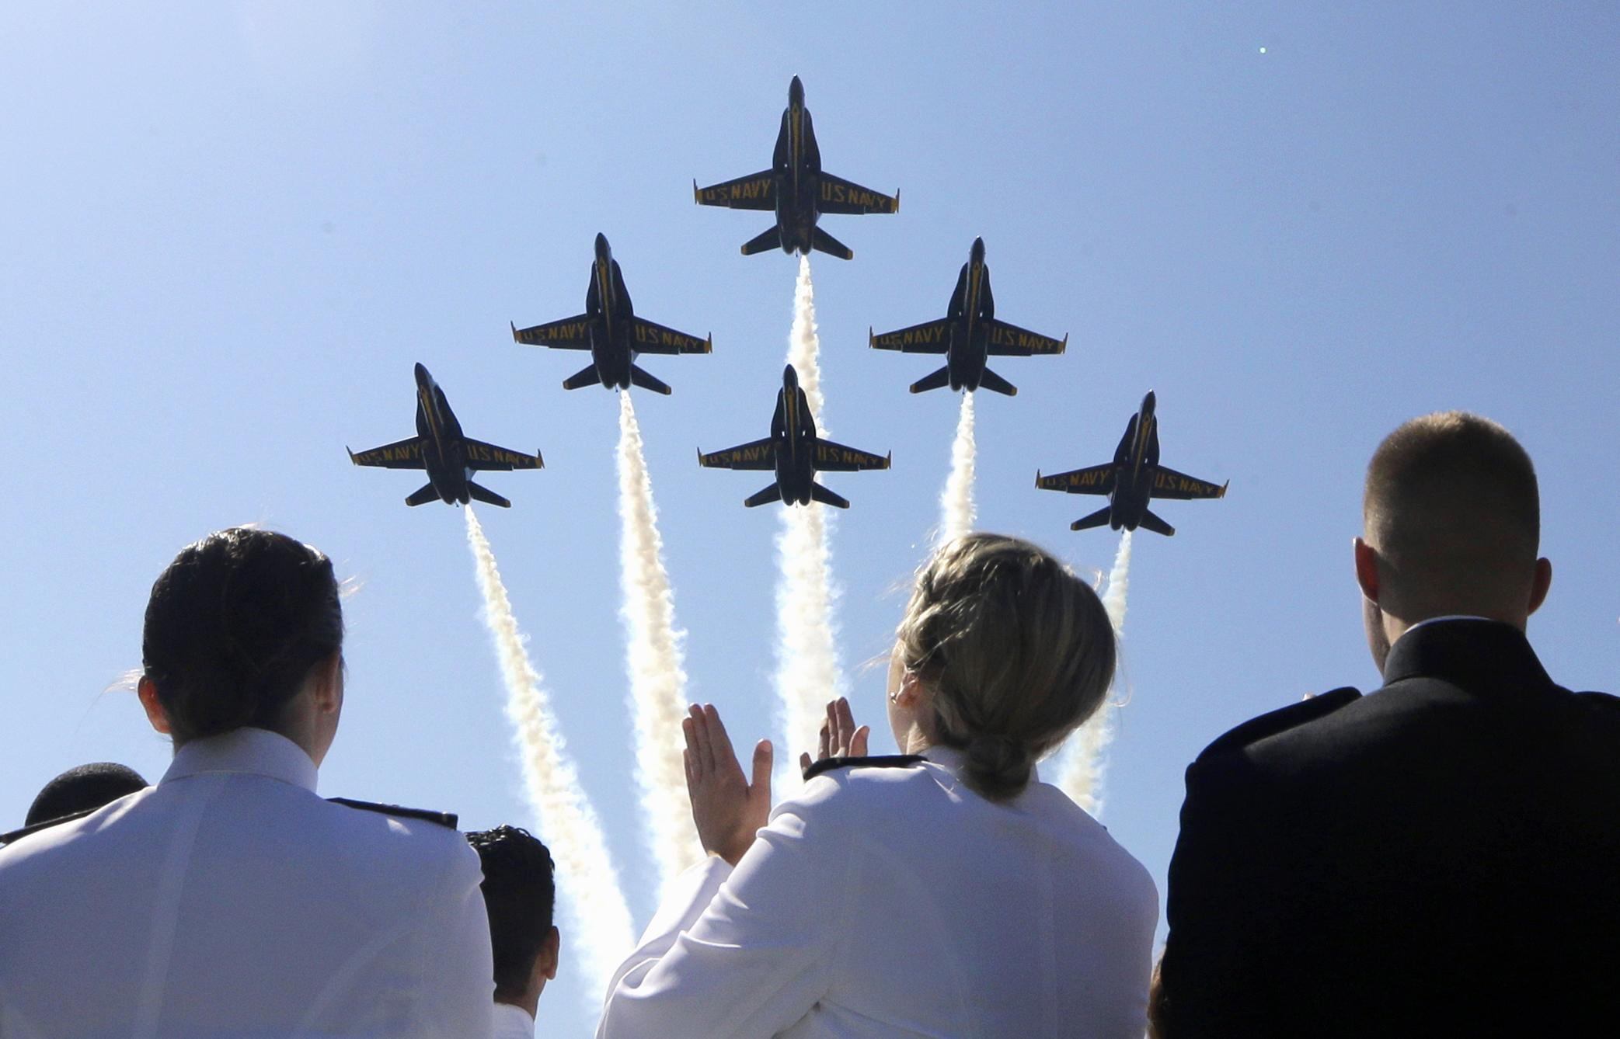
IT Markets
Flying in Formation to
Own the New Operations Center

Slide 28

“Getting to the Next Deal”:
Humana & FAA Adoption Journey
Next Level of Customer Success
Ines Thornburg | Director of Customer Success, AMER

Slide 29
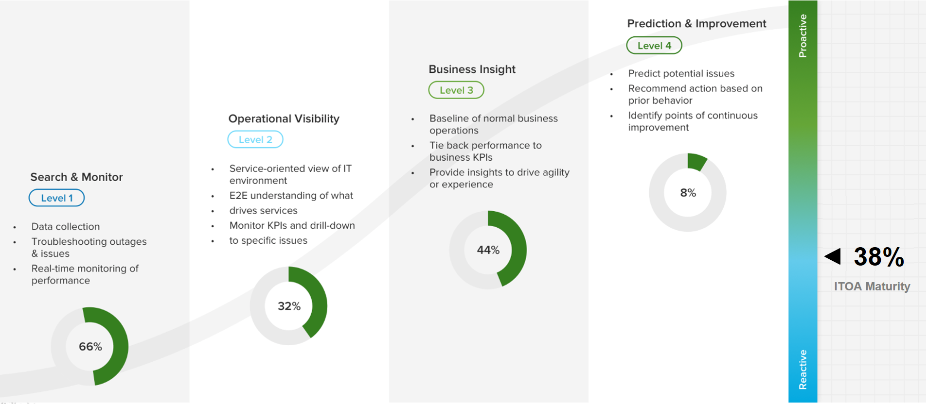
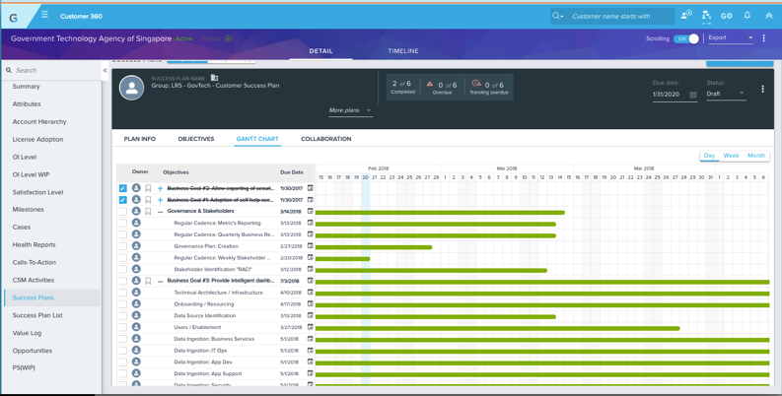
Drive More Customer Success: Adoption
Using the Prescriptive Value Path ( PVP- BVA Assest)
LAND
ADOPT
EXPAND
RENEW
Drive FASTER Adoption Journey
Human-Touch CSM
Drive More Opportunities Faster
Ease Renewals
Digitized CSM
Prescriptive Value Path(s)
Telemetry | Adoption Metrics
Adoption Best Practices
Notes:
Accelerating adoption using the PVP
Tighter alignment during the Sales handoff
Focused conversations on Customer maturing in ITOA/Security and how to identify and prioritize use cases
2 customer success stories today demonstrating how the CSM collaborated with the Account Team and Customer, using the PVP tools to develop a Success Plan, accelerate adoption leading to stronger renewal/expansion conversations

Slide 30




Fitting Splunk into Monitoring Strategy
Provides a Perspective on Current/Future Use Cases
For internal use only – Splunk Confidential
Notes:
Deal sold by Marva and her team back in 2017
Fantastic example of strong teaming initially to identify the initial goals, find quick wins and set up the customer for long term success and expansion
DSA tool used during initial discovery to launch the Splunk discussions
Year 1 - project was called Go-Wide - laying the “Splunk Pipes” and foundation to set up the Monitoring for their most critical 50 Apps
Typical hardships of early deployments - difficulty in procuring hardware, governance, overall traction
PS and CSM team were critical with Data Onboarding, COE and Best Practices sharing, etc

Slide 31

Fitting Splunk into Monitoring Strategy
Year 1: Go-Wide - Monitor Top 50 Critical Apps
For internal use only – Splunk Confidential
Notes:
Alerting and Monitoring
Delivered 22 new compliance, risk and threat monitoring use cases
Internal thread containment achieved in 12 hours vs. days / months!
Documented and Standardized response processes for CSOC alert use cases
Automation of Repeatable Processes
Automation / augmentation of malware detection realized in 5 mins vs. 24+ hrs.
Automated four standard response use cases, reducing manual ticket creation by 17%.
Advanced Analytics
Delivered ML enabled predictive models for volumetric attack for 3 digital assets (Humana.com, Go365.com, and Pharmacy.com)
Delivered ML enabled predictive model for IVR member spoofing model.
Despite modest accomplishments, the progress was very slow!!
Frustration was building across Humana - especially at the Exec levels
_______________________________________________________________________________________

Slide 32

Customer Success Plan
PVP Results | 2019 Use Cases
For internal use only – Splunk Confidential
Notes:
Brian Vanderhorst (RSM), Ryan Fixell (CSM), Matt Larimore (SE)
Not seeing value in Premium Apps – ES, UBA, Phantom
Only Splunk Core was being used for basic Security Use Cases
Humana was not realizing value from Splunk Premium Apps, functionality was not understood, renewal was at risk
Guidance to mature the CSOC
Humana seeking Best Practices and recommendations to strengthen their security posture
Infrastructure Investment
Humana needed justification on the investment to expand their environment
CSM Introduced the Security PVP
Security PVP Maturity Assessment to Identify key Use Cases to accomplish Humana’s goals
Accelerate the Splunk adoption, securing a stronger renewal and outlining the plans for expansion later in 2019
__________________

Slide 33

Success Planning: ITOA Use Case
PVP Results: 2019 Strategic Roadmap
Urgency Not Set
Capability Level
Maturity Levels to be Addressed
Value Path
Application Release Analytics
Level 1
Level 2
Level 3
Level 4
Application Analytics
Application Lifecycle Analytics
Level 1
Level 2
Level 3
Level 4
Application Analytics
Immediate
Capability Level
Maturity Levels to be Addressed
Value Path
Server & OS Monitoring
Level 1
Level 2
Level 3
Level 4
IT Troubleshooting & Monitoring
Infrastructure Troubleshooting
Level 1
Level 2
Level 3
Level 4
IT Troubleshooting & Monitoring
Event Management
Level 2
Level 3
Level 4
Data Driven Service Intelligence
Within 9 Months
Capability Level
Maturity Levels to be Addressed
Value Path
Application Monitoring and Triage
Level 2
Level 3
Application Analytics
Within 18 Months
Capability Level
Maturity Levels to be Addressed
Value Path
Service Insight
Level 1
Level 2
Level 4
Data Driven Service Intelligence
* Optional
For internal use only – Splunk Confidential
Notes:
Drew King, RSM
Ermyus Haile, CSM
Tavar Smith, SE
Steve Fritzinger, BVC
FAA - PVP can be positioned at ANY point in the customer lifecycle
-Continuous Diagnostic Mitigation Program (CDM) - DHS (Homeland Security) gives $$ in Analytic tools for Cyber Security Use cases - DHS correlates the data to look look for patterns and identify, monitor and track security/threats for the U.S.
-Ermyus Haile worked with CDM to open the doors at FAA - led with security PVP got a lot of traction, then used ITOA PVP then App Monitoring - Strategic Roadmap to to identify Use Cases - part of phases Success Plan
CDM environment is in production
Developing and Land a multi terabyte license FAA opportunity - to deployment
ITOA, App Monitory and other Security Use Cases
FY20 Opportunity
Drew King, Tavar Smith, Ermy, steve Fritzinger, FAA - SSF Program Manager (CIO for FAA)

Slide 34
How To Leverage Incredible Insights
CSM Accounts
Best Practices
Digital Journey
Time to Next Purchase
Value of Next Purchase
552
20,000+
Views
900+
Customers
39% Reduction
$516K Increase
CSM Impact
Customer Engagements
Customer / Sales Impact
Call to Action
Log into the Adoption App in Dogfood!
Understand your Customer’s Adoption Score
Follow the Digital Journey with your customer
Use the Stuck/Stalled Playbooks to drive adoption
Have OnPrem customers turn on Telemetry data
License
Usage
Adoption Score
23% Increase
67% Increase
Digital Impact
Notes:
Q1 FY20 Progress to Date
CSM Reach continues to expand
Touching 535 customers Globally, ~400 across AMER & Pub Sector
20K+ views on our Best Practices site
Reaching 900+ customers that we’ve never touched before with the Digital CSM - Onboarding, Stuck, Stalled, PVP materials
CSM Commercial Impact
Reducing Time to Next Purchase by 39%
Increasing Value of Next Purchase by $516K~
Increasing License usage by 23% and Adoption Score by 67%
Calls to Action !!
Log into the Adoption App in Dogfood!
Understand your Customer’s Adoption Score
Follow the Digital Journey with your customer
Use the Stuck/Stalled Playbooks to drive adoption
Have OnPrem customers turn on Telemetry data

Slide 35





Leverage World Class Customer Success Platform
A
Notes:
CSM Team Tools
Gainsight
Tool that integrates with SFDC, used by CSMs for Success Plans, Use Case Inventory, Health Reports, Activities and Interactions with the Customer around the Adoption motion
Being rolled out to the RSM/SE community in waves over the next few months
Adoption App
Cloud/OnPrem Customers that share Telemetry data
Tracks Adoption and Health Scores relative to each customer’s maturity
Digital CSM pushes content/best practices appropriate to phase of the customer journey

Slide 36




Wrap-Up
Host of The Marva Minute and Tom and Marva Show

Slide 37


Slide 38

Executive Conversation: Teamwork/ Leadership
Tour of California
Morgan Hill: May 14th
Men’s Race
20 customer spots
Doug leading business session with Freddie, Global Operations
Trek Ambassadors – Ivan Basso & Jens Voigt
Pasadena: May 17-18th
Men’s & Women’s Races
24 tickets – customer/guests
Christian leading business session with Freddie, Global Operations
Trek Ambassadors – Kathryn Bertine & Jens Voigt

Slide 39
Premiere Global Executive Experience Session
Tour de France: July 26-29, Paris – Final Stage
16 customer tickets + 16 guest = 32 spots
Invite Process -
Rolling Nominations
Theatre lead and legal review
Senior customer event
Priority to strategic key accounts
Doug and theatre leads to host customers

Slide 40



Innovation Jam: North America BOTS Day – June 19th
Engage with Exec Sponsor!
What is it?
Multi-city, single day competition for teams of 4
Significant online and social buzz
Hosted by Security Specialists and Sales leaders
Schwag, Trophy and Patch for winners!
Who to Invite?
Users, Managers, Directors
Security architects, SOC Managers
Objective
Expand customer adoption of Splunk for Security
Introduce Splunk Enterprise Security
Train customers on how to use Core Splunk more effectively
DC | NYC | Atlanta | Toronto | Chicago | Houston | Seattle | San Jose | St. Louis | Orange County | Denver

Slide 41



#MotivationMonday Wrap
1
2
3
Strive to Be memorable, personal, and always think/see through the lens of the client.
Today’s slides & recording will be posted in AMER All Sales Chatter Group Next Alley Rally
July 1st-
Get familiar:
NEW Product Enablement &
Predictive Pricing Option
.
Trust and Leverage your extended team. That could be your eco-system, customer, personal board of directors.

